Slide 1

Learning Together at the
@R4DScommunity
Online Learning Community
April 19, 2022
8:00 pm - 10:00 pm (GMT +3)

Slide 2
Agenda
Time | Activity | Speaker/ Moderator
8:00 pm – 8:05 pm | Participants joining | Shel Kariuki
8:05 pm – 8:15 pm | Welcoming remarks and introducing the speaker | Shel Kariuki
8:15 pm – 9:00 pm | Talk | Jon Harmon
9:00 pm – 9:30 pm | Q & A | Njoki Lucy
9:30 pm – 9:40 pm | Closing remarks | Njoki Lucy

Slide 3
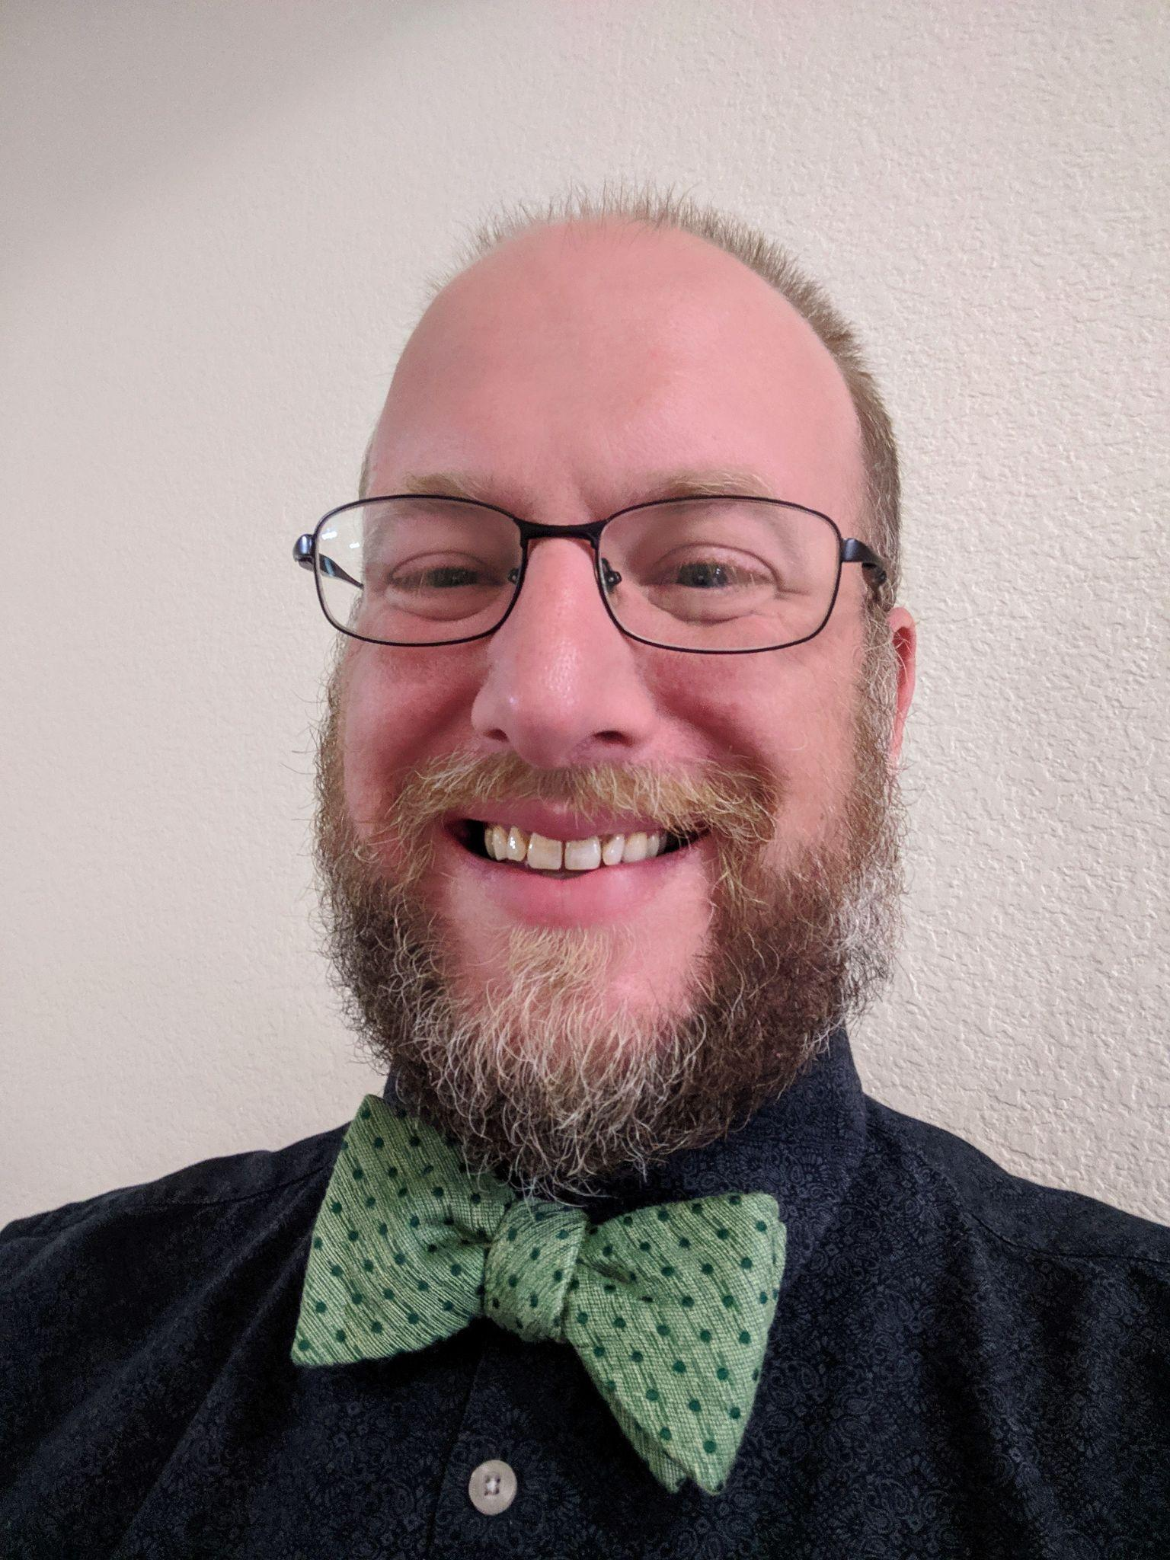
Our Speaker
Jon Harmon
Principal Data Scientist, Macmillan Learning

Slide 4
Talk Session

Slide 5
Q & A

Slide 6
THANK YOU!!
Email address: nairobi@rladies.org
LinkedIn: R-Ladies Nairobi
Twitter: @RLadiesNairobi
Meetup: https://www.meetup.com/rladies-nairobi/

